Slide 1
Teen Safe Driving
Burlington County 9-1-1
PUBLIC EDUCATION

Slide 2

A LITTLE HISTORY
1991: Enhanced 9-1-1 begins in Burlington County replacing seven digit municipal emergency numbers
Enhanced 9-1-1 provides location information based on landline phone addresses

Slide 3
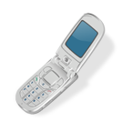
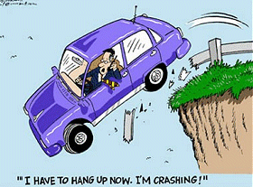
TODAY
68% of the calls received by Burlington County 9-1-1 are from cell phones.
Cell phone distractions are the leading cause of teenage car crashes/fatalities.

Slide 4
TECHNOLOGY TODAY
You can use your cell phone to dial 9-1-1 in the event of an emergency.
    Cell phones are great tools when used correctly but can be dangerous when abused. You should never drive and use your cell phone together.
Technology is Limited
  Currently, you cannot text message 9-1-1 for help or assistance.
  9-1-1 can use cell phone towers to help narrow down your location but it does not have the precision many people think…

Slide 5
SCENARIO #1
You are at a house party where you have never been before. You follow your friends to the house and they need to leave early.
On your way home, you swerve off the road and get your car stuck in the ditch. Your friend in the passenger seat is unconscious.
        What do you do?

Slide 6
SCENARIO #2
You are involved in a car accident and the person you accidently hit is out of control and yelling. You are afraid and scared.
  Who should you call first?

Slide 7
Call 9-1-1
Tell the operator where you are
Report any injuries to the operator
Follow the operator’s instructions
You may be able to help the injured until help arrives

Slide 8
Call 9-1-1
Tell the operator where you are
Report any injuries
Stay on the phone with the operator until help arrives if you are afraid

